Slide 1

How Docker Fits into the DevOps Ecosystem?

Slide 2





What will you learn today?
What is Docker ?
How Docker Container is different from Virtual Machines ?
Docker a DevOps ally
DevOpping with Docker
Hands-On Getting Started with Docker

Slide 3
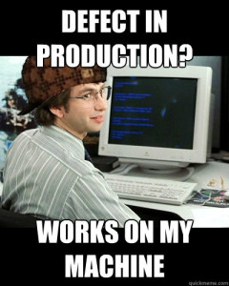
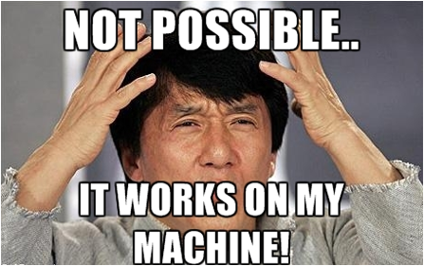
Familiar Expressions, Isn’t It

Slide 4
What’s the problem ?
Development and Production environment are not the same

Slide 5

How to solve it ?
Make sure Development and Production environment both are same

Slide 6
Docker

Slide 7

Docker
Docker is an open platform which packages your application, dependencies and configurations together to ensure that your application will work seamlessly in any environment on any infrastructure just like it did on your machine

Slide 8

Deep Thoughts …
So does that mean Docker is a virtual machine?

Slide 9
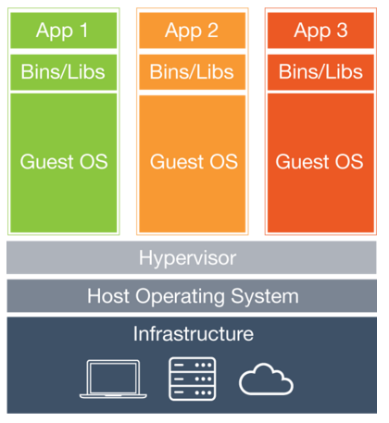
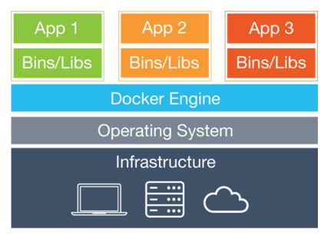
Difference between Docker and Virtual Machines
Docker containers share the kernel with other containers while in Virtual Machines each application
ships with its own guest operating system
Docker Containers
Virtual Machines

Slide 10
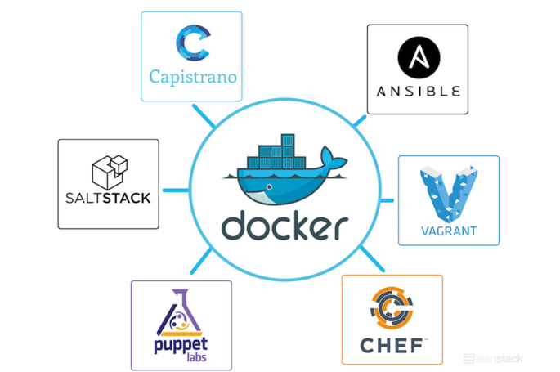

Docker – a DevOps ally
Docker has been designed in such a way that it can be incorporated into most DevOps tools including Puppet, Chef, Vagrant, and Ansible etc.

Slide 11
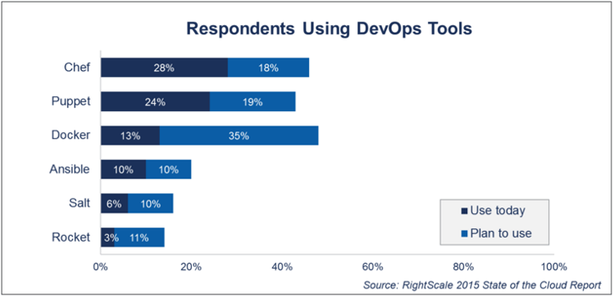
DevOpping with Docker

Slide 12
Hands-on
Getting Started With Docker

Slide 13
References
Red Hat and Docker together :
http://opensource.com/business/13/11/docker-fedora-red-hat-collaboration
Docker Soars in DevOps:
http://www.rightscale.com/blog/cloud-industry-insights/cloud-computing-trends-2015-state-cloud-survey
How Docker helped achieve almost Impossible :
http://www.iron.io/blog/2014/04/how-docker-helped-us-achieve-near.html

Slide 14
Survey
Your feedback is vital for us, be it a compliment, a suggestion or a complaint. It helps us to make your experience better! Please spare few minutes to take the survey after the webinar.

Slide 15
Thank You …
Questions/Queries/Feedback
Recording and presentation will be made available to you within 24 hours

